Slide 1
How does text become data?
Rob Speer & Catherine Havasi
Luminoso / ConceptNet
havasi@luminoso.com
Notes:
Intro –

Slide 2
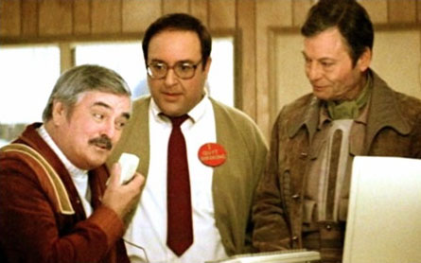
Wouldn’t it be cool if we could communicate with a computer?
Notes:
With the prevalence and prominence of Natural Language Processing, it can be really tempting to try to add NLP to whatever you’re developing. People are beginning to expect, or at least to wish, they could interact with a computer in a more natural way.

Slide 3
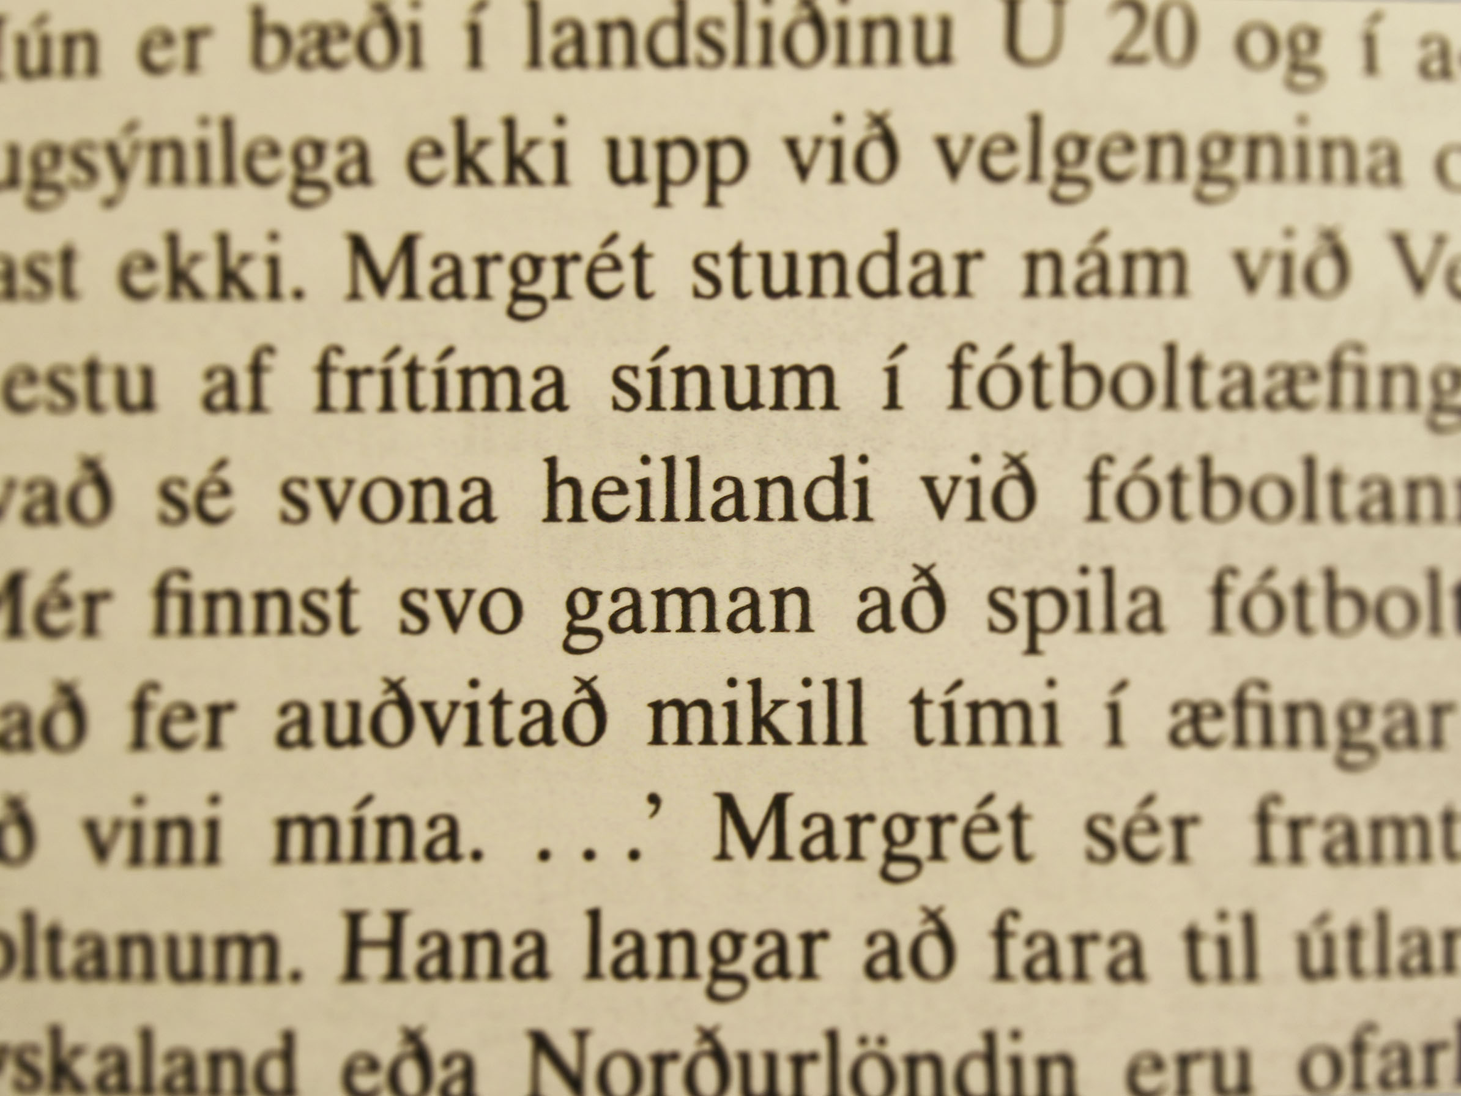
Text
Notes:
Here’s the problem. To a computer, your text still looks like this. Unless you’re Icelandic, you probably find this text pretty incomprehensible.
But your computer finds it even less comprehensible. At least you can assume that “Margret” is a name, for example. There are a lot of issues holding computers back from understanding language but there are also a lot of easy work arounds and a lot of open source software that can help you.

Slide 4
Language is ambiguous (and you can’t really fix it)
Notes:
When you start working with text, you may quickly run into the fact that language is full of ambiguity.
You may see this as a bug and decide you need to fix it. And that’s where you’ll get stuck, because you can’t take all the ambiguity out of language.
You will always run into text with multiple interpretations such as... [go to following slides]

Slide 5
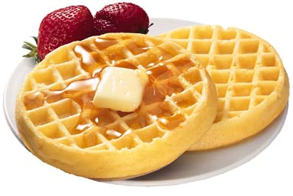
“British left waffles on Falkland Islands”
Notes:
(list these examples quickly)

Slide 6
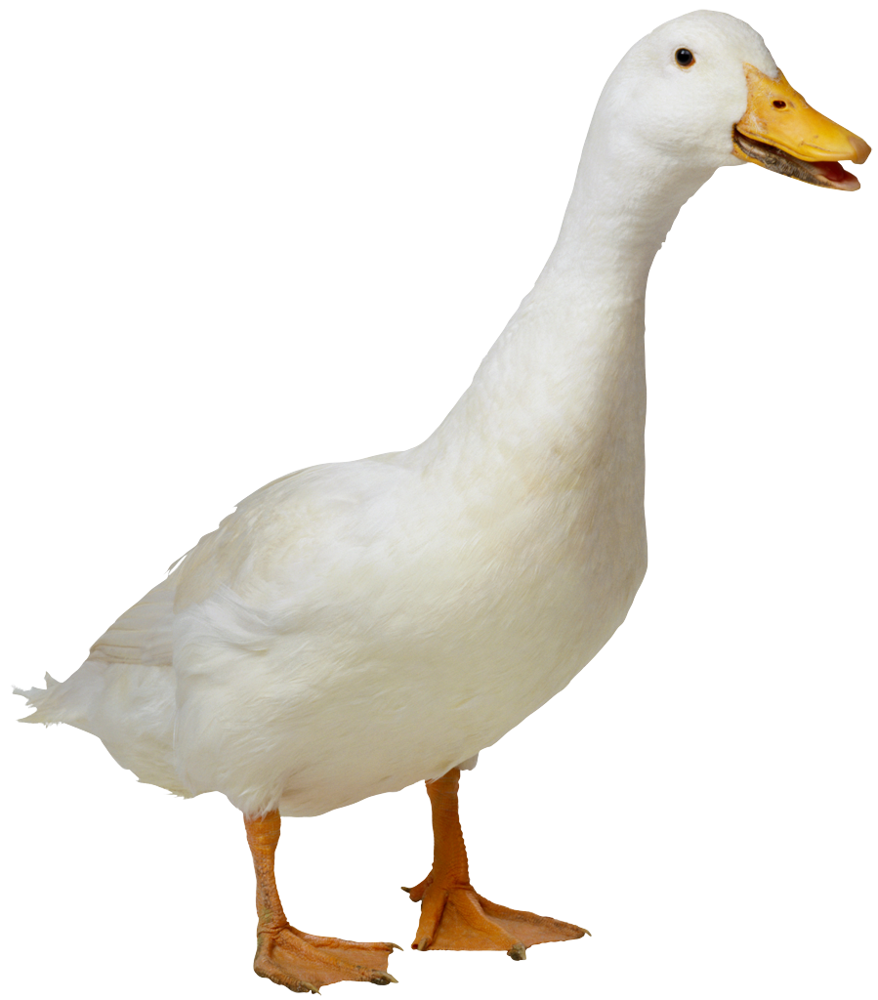
“I made her duck”

Slide 7
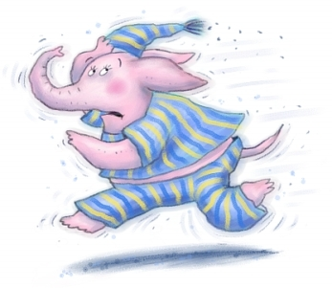
“I shot an elephant in my pajamas”
Notes:
Grocho Marxv They key to working with language is not to try to fix it’s difficulties but to embrace them

Slide 8
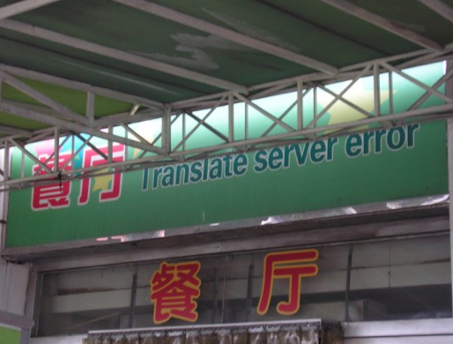
A multi-lingual world
Notes:
The world – and the internet – are becoming increasingly multilingual. Making solutions that generalize easily...

Slide 9
You can still get things done.
Notes:
Lots of big ideas. We’re going to focus on the things computers can accomplish right now. What sorts of things might you want to do with NLP?

Slide 10
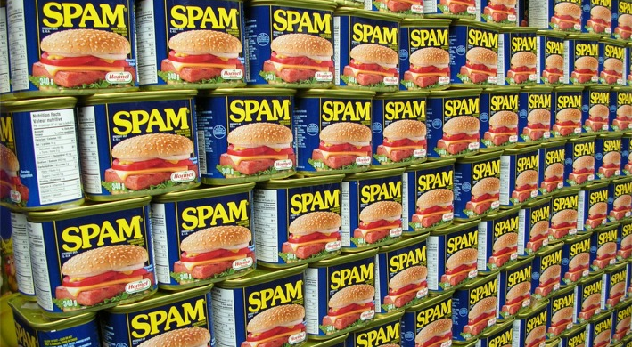
Classification
Notes:
How do we filter out comments on a website that are likely to be trolls or spam? How do we find the angry or awesome emails and bob them up to the top so they get answered more frequently? How do we classify user interests so people find the news items or posts their most interested in?

Slide 11
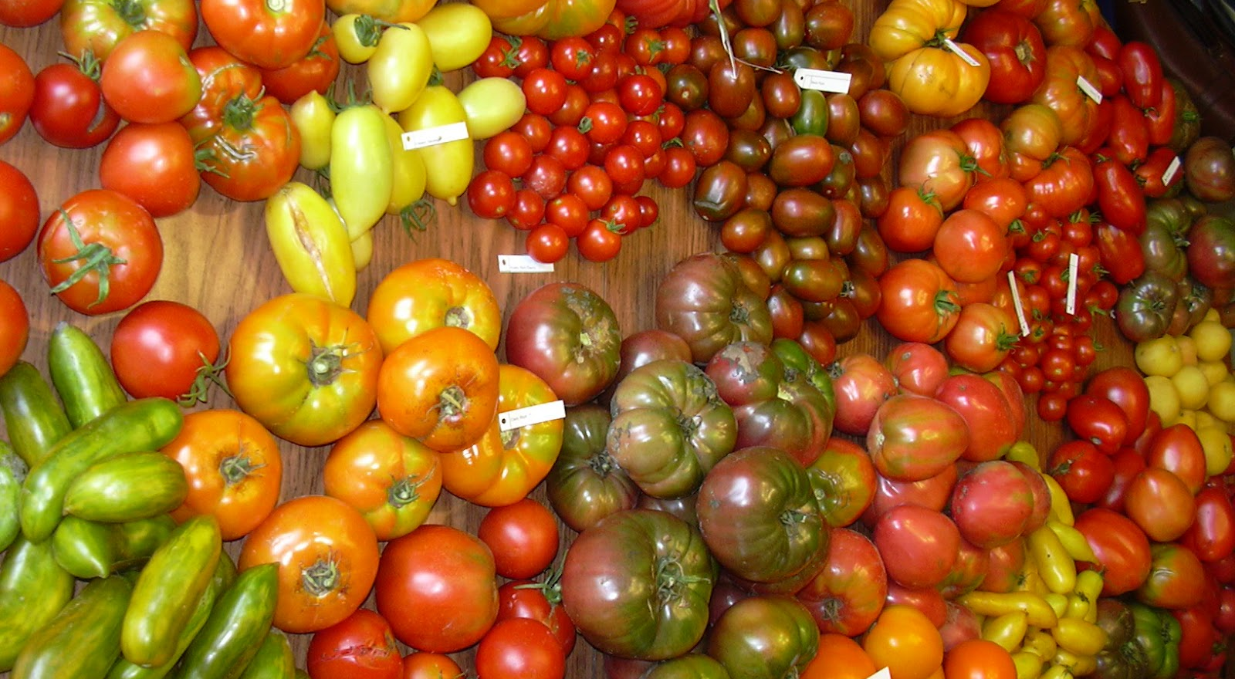
Similarity between documents
Notes:
Find the outliers in a bunch of news articles or mailing list posts? Figure out often your organization receives certain types of messages? Recommend things people might want to read?

Slide 12
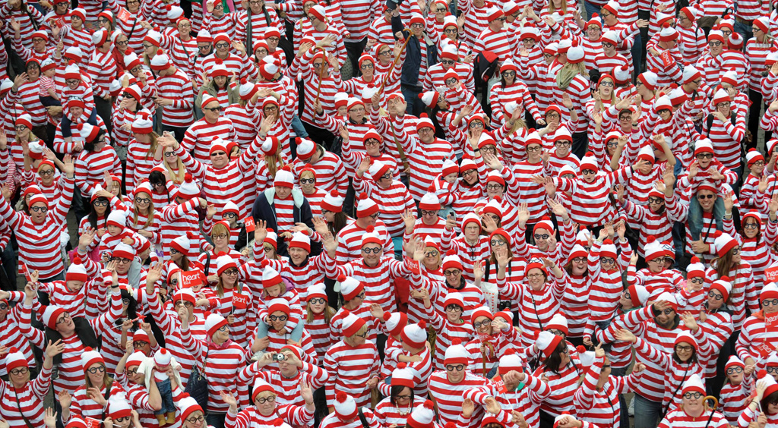
Search
Notes:
How can people find the information they’re looking for, even if the words they used don’t appear exactly in the text they want to find?
[THE NEXT SLIDE IS THE HANDOFF POINT]

Slide 13
In this talk
A tour of useful data-driven NLP techniques
Starting with the simple things you can do right now
Here’s the code for this talk:
http://github.com/rspeer/text-as-data
Notes:
I’m going to give a whirlwind tour of common and useful data-driven representations of text.
Here I’m presenting the things you can do in a small amount of Python code. I don’t want this to be the sort of NLP talk where you come away saying “oh, that was neat, I wonder when someone will make it work a second time”. I want you to come away with code you can use if you want to. We’ll get to just a bit of more speculative stuff at the end.

Slide 14
Python example: word splitting and normalizing
Notes:
[Python example 1]

Slide 15
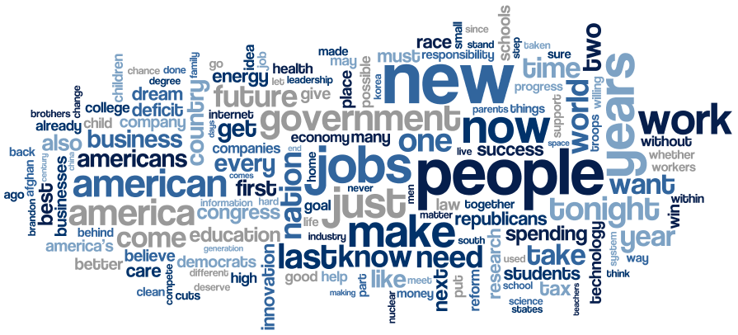
Simple word counts
Notes:
“bag of words” representation
These word clouds make me sad.
Position means nothing
Orientation means nothing
Color means nothing
Font is named “Coolvetica”

Slide 16
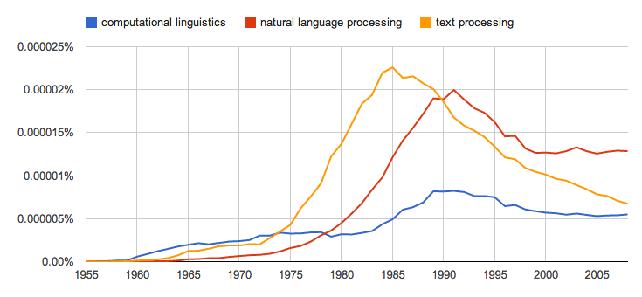
N-gram models

Slide 17
Documents are “bags of words”
 | woe | betray | revenge | death | alas
Julius Caesar | 2 | 1 | 4 | 31 | 9
Hamlet | 9 | 0 | 12 | 37 | 9
Macbeth | 2 | 2 | 3 | 21 | 4
Notes:
We will often reduce a text to just its word counts, as if the text was a bunch of unordered words in a bag. This is because we don’t really know what to do with grammar anyway.
These go on for hundreds of thousands of words

Slide 18
Which N-grams are interesting?
“vice president”
is more interesting than
“the vice”
which is more interesting than
“of the”

Slide 19
Which N-grams are interesting?
Consider this contingency table:
p(vice, president) | p(vice, ~president)
p(~vice, president) | p(~vice, ~president)

Slide 20
Python example: interesting N-grams
Notes:
[Python example 2]

Slide 21
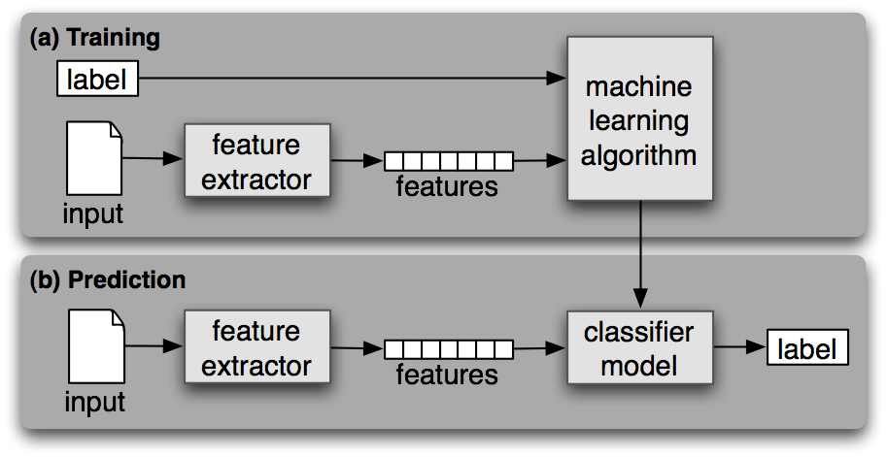
Text classification
from “Natural Language Processing with Python”,
by Steven Bird, Ewan Klein, and Edward Loper (O’Reilly, 2009)
Notes:
plug for the NLTK book

Slide 22
Text classification
probably
bag-of-words
possibly
Naive Bayes
from “Natural Language Processing with Python”,
by Steven Bird, Ewan Klein, and Edward Loper (O’Reilly, 2009)

Slide 23
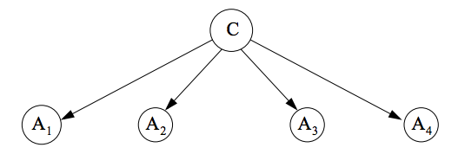
Overview of Naïve Bayes classification
The probability that a document is in class C depends on its features, A_{n}
Assume all features are statistically independent
Notes:
NB made a triumphant burst onto the NLP scene with Paul Graham’s “A Plan for Spam”. Suddenly, in 2002, you didn’t have to sort your own spam anymore.

Slide 24
Python example: Classification with NLTK and scikit-learn
Notes:
[Python example 3]

Slide 25
Text similarity
Bags of words can tell us how similar documents are
 | woe | betray | revenge | death | alas
Julius Caesar | 2 | 1 | 4 | 31 | 9
Hamlet | 9 | 0 | 12 | 37 | 9
Macbeth | 2 | 2 | 3 | 21 | 4
Notes:
We can somewhat see that Hamlet is different from Caesar and Macbeth, because Hamlet features vengeance while the others feature betrayal.

Slide 26
Text similarity
Bags of words can tell us how similar documents are
 | woe | betray | revenge | death | alas
Julius Caesar | 2 | 1 | 4 | 31 | 9
Hamlet | 9 | 0 | 12 | 37 | 9
Macbeth | 2 | 2 | 3 | 21 | 4
Alice in Wonderland | 0 | 0 | 0 | 1 | 4
Notes:
And Alice in Wonderland, another text we can load using NLTK, features neither betrayal nor vengeance.
There should be hundreds of thousands of columns here.

Slide 27
TF-IDF normalization
Some documents are longer than others
Some words appear more than others
 | woe | betray | revenge | death | alas
Julius Caesar | .046 | .018 | .139 | 0 | .159
Hamlet | .142 | 0 | .287 | 0 | .110
Macbeth | .053 | .041 | .120 | 0 | .082
Alice in Wonderland | 0 | 0 | 0 | 0 | .054
(TF-IDF values × 1000, from NLTK’s Project Gutenberg)

Slide 28
TF-IDF normalization
TF replaces term counts with term frequencies
IDF tells us how much information we get when a word appears
In NLTK’s Project Gutenberg corpus:
IDF(the) = 0 bits
IDF(death) = 0 bits
IDF(taxes) = 2.58 bits
IDF(whale) = 2.17 bits
IDF(Ishmael) = 3.17 bits
Notes:
It’s mostly the Bible that has taxes, but everything has death.

Slide 29
Vector-space similarity
Similar texts have a small angle between them
Macbeth
Alice in Wonderland
Julius Caesar
Hamlet
Notes:
A mess of documents and terms is going to become a vector for each document and each term. This is how we turn bags of words into a vector space model.

Slide 30
Dimensionality reduction
Put terms and documents in a lower-dimensional space where we can easily compare them
In NLP, this is called Latent Semantic Analysis or Latent Semantic Inference
Notes:
“Lower-dimensional” doesn’t mean the 2 or 3 dimensions you can visualize. It means 50 to 500 dimensions. Still much smaller than, say, sparse vectors over 100,000 possible terms.

Slide 31
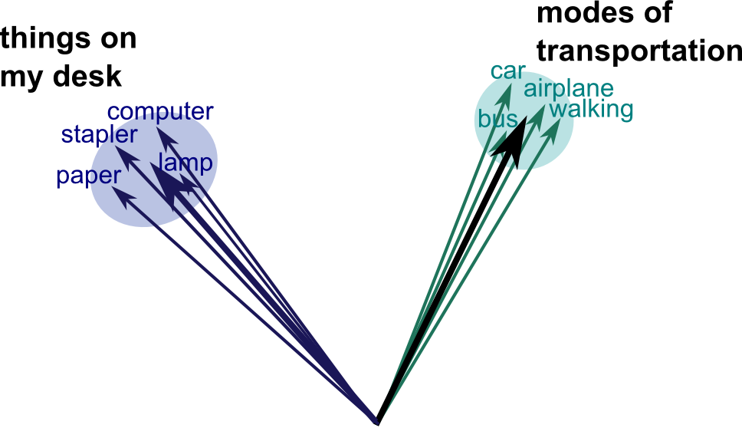
Vector spaces group words and documents by meaning
Notes:
This approach has sometimes been criticized: “Everything is linear. How interesting can that be?” But recently this has changed to “Everything is linear. That’s really useful!”

Slide 32
Python example: Unsupervised text similarity using gensim
Notes:
[Python example 4]

Slide 33

Similarity of movie reviews

Slide 34
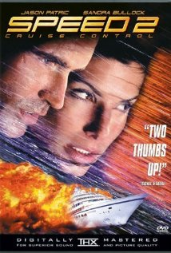
Similarity of movie reviews

Slide 35

Similarity of movie reviews
Notes:
[switch back to Python example, to illustrate why we need non-domain knowledge]

Slide 36

Is this all there is to word meaning?

Slide 37
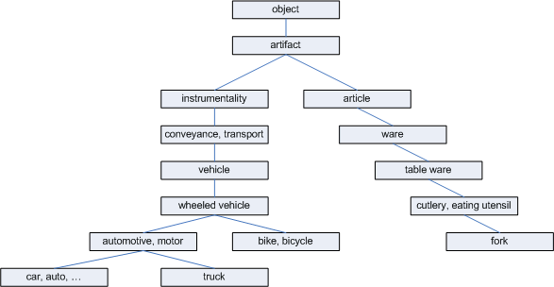
Modeling word meanings
Image source: “WordNet-based semantic similarity measurement”
by Troy Simpson and Thanh Dao, on codeproject.com
Notes:
A bit too rigid. You might not just want to know that a fork is an “article”, when what’s more relevant is that a fork is for eating.

Slide 38
I bought groceries at the store.
Notes:
If you think about computer understanding of text, think about a simple sentense

Slide 39
buy groceries
requires
money

Slide 40
cook
requires
buy groceries
requires
money
location
location
wallet
bank

Slide 41
cashier
expense
location
supermarket
related to
has
doesn’t want
requires
spend
cook
person
is for
type of
requires
wants
buy groceries
takes object
has verb
has
takes object
requires
buy
money
building
requires
takes object
has object
takes object
location
location
type of
groceries
food
part of
wallet
bank
has
type of
is for
location
type of
produce
pocket
company
Notes:
Compared to an expert-created resource such as WordNet, this might look like a big disorganized mess.
But a big disorganized mess is exactly the right input to dimensionality reduction.
We do what we did before, but instead of a matrix of terms vs. documents, we use a matrix of which terms are connected to which other terms.

Slide 42
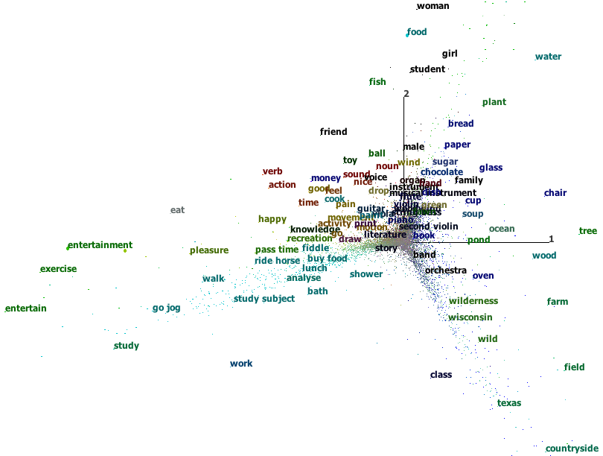
ConceptNet as a vector space
Notes:
We have a large amount of knowledge we want to make useful to computers. Once again we can use SVD. Terms vs. related terms, not terms vs. documents

Slide 43
Python example: Querying ConceptNet
See API documentation linked from:
http://conceptnet5.media.mit.edu
Notes:
[Python example 6]

Slide 44
Many incompatible representations
Supervised text classification
Unsupervised document similarity
Domain-general word associations

Slide 45
Many incompatible representations
Supervised text classification
Unsupervised document similarity
Domain-general word associations
It would be nice if one model could do all of these.
Notes:
[...and this is where you talk about Hub]

Slide 46
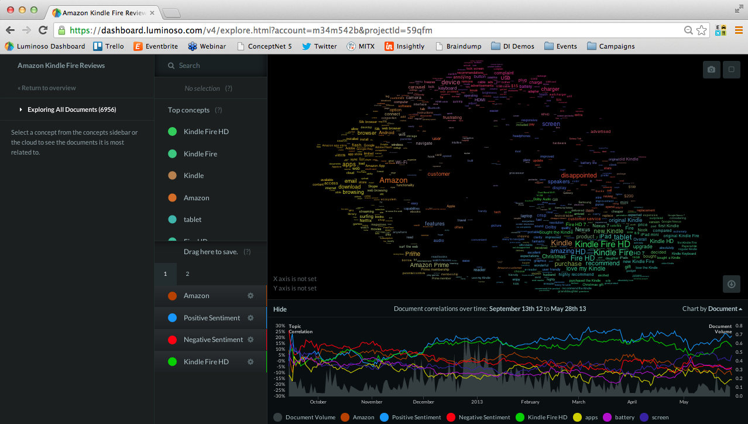

We made Luminoso
Notes:
We’ve shown you some easy things about NLP. We made a company about doing the hard things, and giving you cool visualizations of what’s going on in your text.
Right now we have paying customers such as Mars chocolate and Scotts lawn care. But we want to make a public version.

Slide 47
We want you to get more information out of text. We want everyone to be able to play. Help us alpha or beta test. (We’ll give you free access.) Email us: hub@luminoso.com

Slide 48
That’s all
Code and slides:
http://github.com/rspeer/text-as-data
Cool things we work on:
http://conceptnet5.media.mit.edu
http://luminoso.com
Email us: havasi@luminoso.com

Slide 49
Extra slides

Slide 50
Python example: Querying WordNet
Notes:
[Python example 5]

Slide 51
But Naïve Bayes is so naïve!
Sure, its fundamental assumption is wrong
Often, it works anyway
On NLP tasks, NB is blazingly fast and surprisingly effective
(See “The Optimality of Naive Bayes”, Harry Zhang, AAAI 2004)
Notes:
This doesn’t mean that NB is the solution to everything. But it’s something you should try first. If you’ve found a fancy solution to your problem that takes n^2 hours where n is the number of documents, you should ask yourself, “Does this perform better than Naive Bayes?”

Slide 52
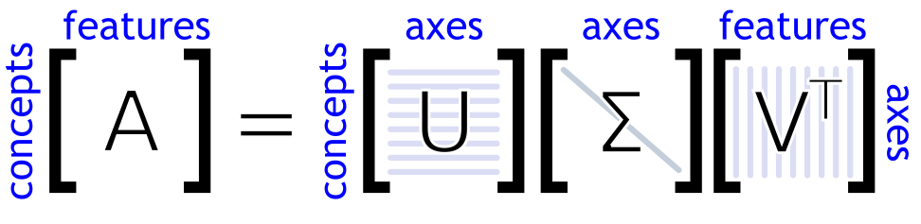
Dimensionality reduction
documents
documents
terms
terms
Notes:
Some people call axes “topics”. I consider this misleading.

Slide 53

Dimensionality reduction
documents
documents
terms
terms
Notes:
Some people call axes “topics”. I consider this misleading.

Slide 54
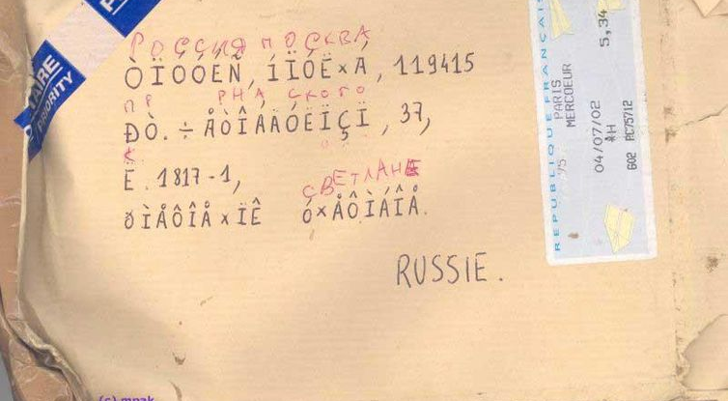
A multi-lingual world
Notes:
And while connectedness is great, it poses even deeper problems for NLP

Slide 55
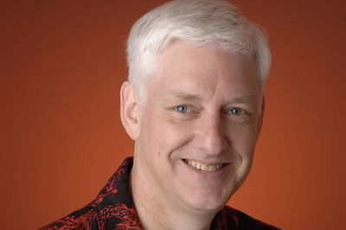
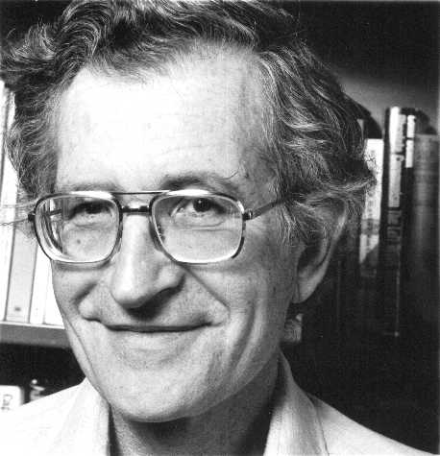
“Much Debate”
Notes:
Lots of theoretical approaches to language and lots of very broad and lofty ideas and famous arguments between great minds about the right way to approach the grand problem. It’s the kind of thing that gets XKCD comics made out of our field

